Slide 1
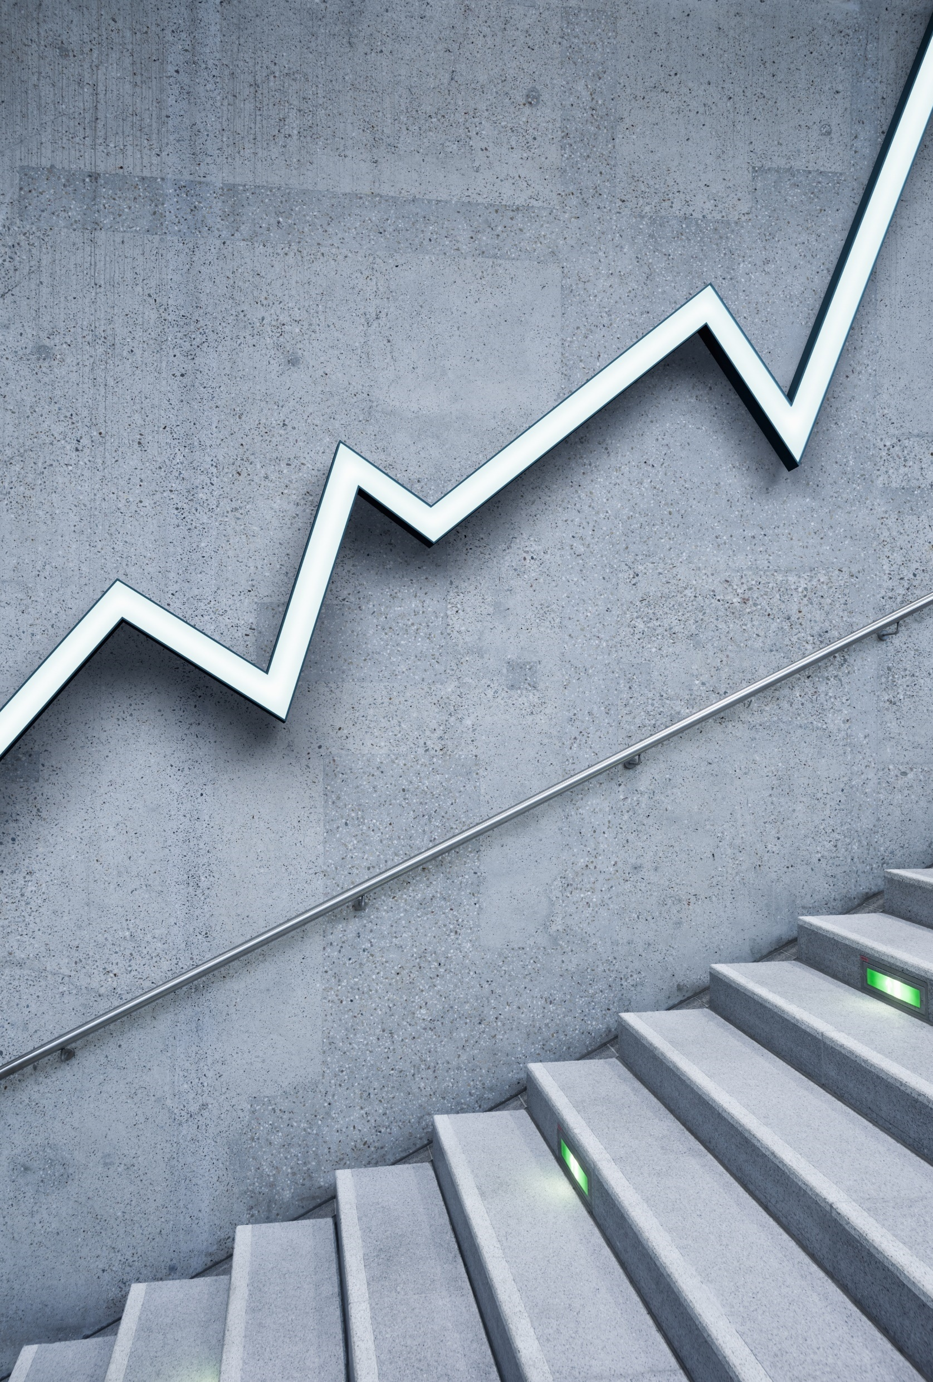
FDI DATA ANALYSIS
Fiza Fahameen M

Slide 2
Introduction Foreign Direct Investment (FDI) plays a pivotal role in the global economy, serving as a catalyst for economic growth, technology transfer, and job creation. In this analysis, we delve into the dynamics of FDI to uncover insights and trends that can inform strategic decision-making and policy formulation.
Definition of FDI and its significance in economic development.
Purpose of the analysis: to explore FDI patterns, drivers, and implications.
Importance of understanding FDI dynamics for stakeholders, including policymakers, investors, and businesses.
Through this analysis, we aim to provide a comprehensive understanding of FDI trends, sectoral distributions, regional disparities, and temporal changes, offering valuable insights for maximizing the benefits of FDI and fostering sustainable economic development.

Slide 3
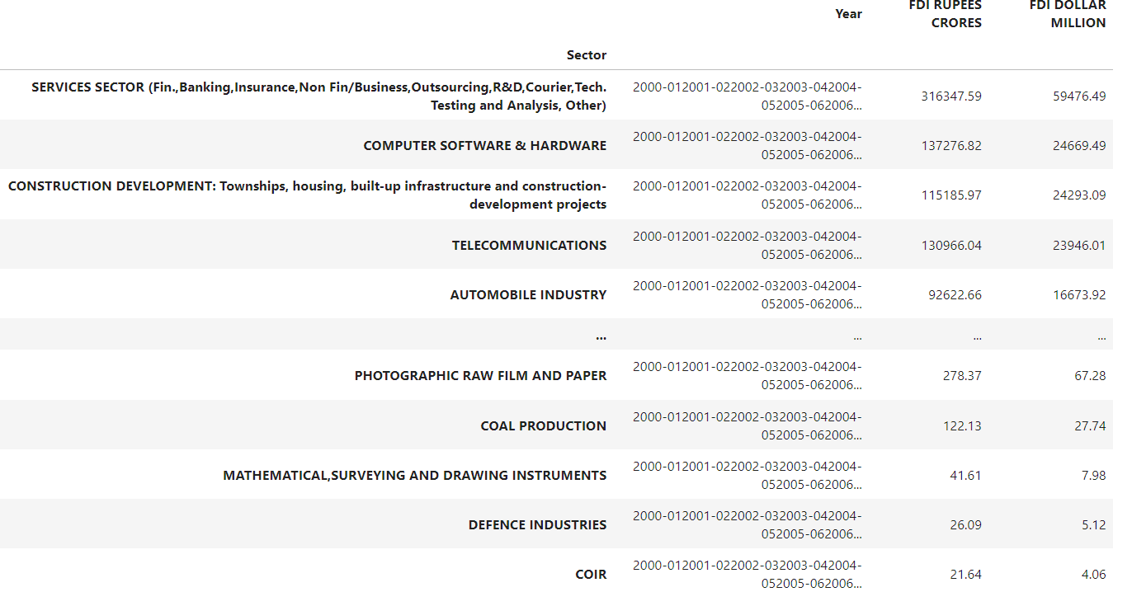
FDI INVESTMENT

Slide 4
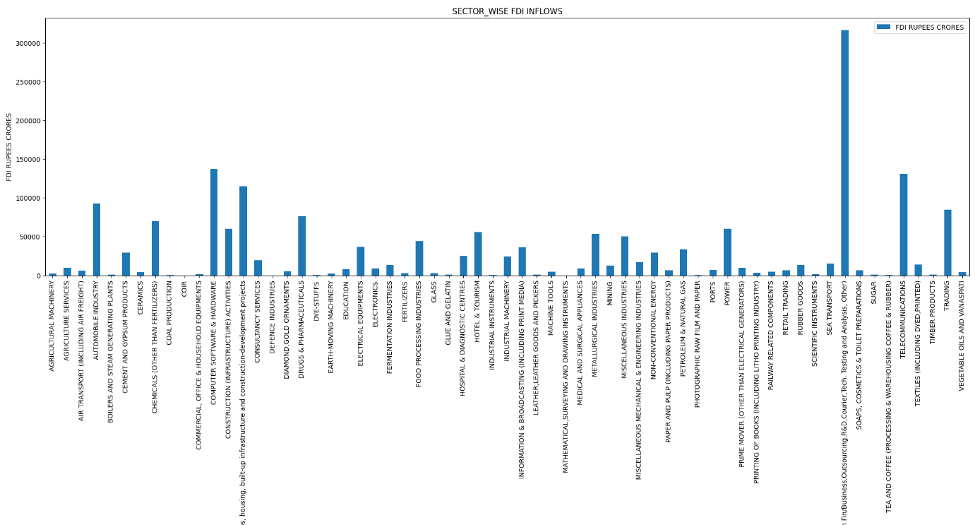
FDI SEGMENT BASED INVESTMENT - CRORES

Slide 5
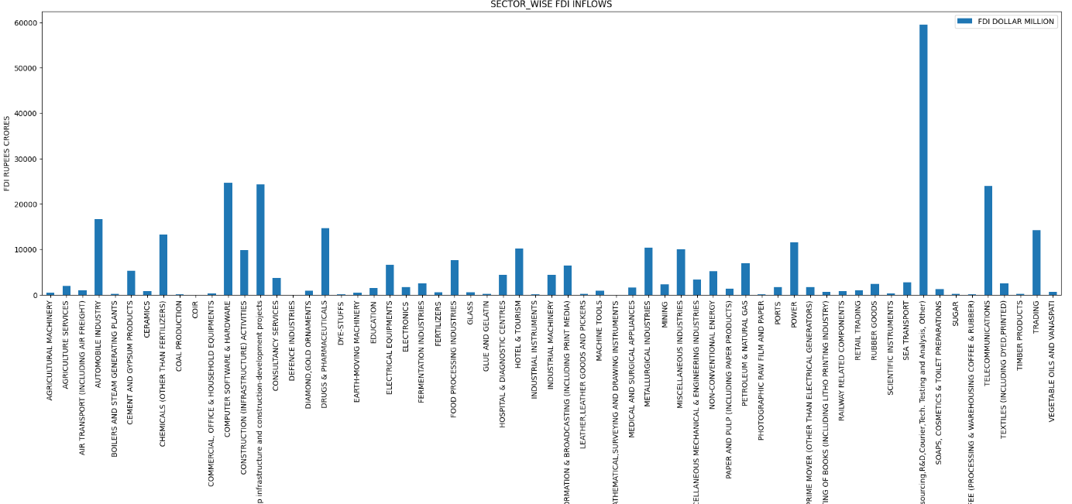
FDI SEGMENT BASED INVESTMENT - DOLLARS

Slide 6
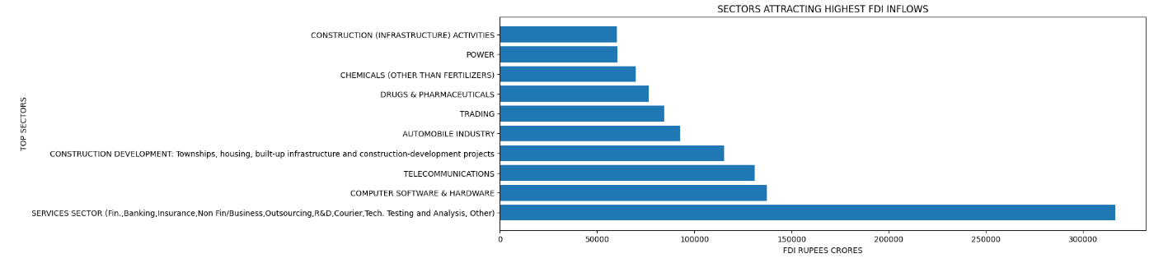
FDI INVESTMENT
THE TOP SECTORS INTERESTED THEM
SERVICES SECTOR, COMPUTERS,TELECOMMUNICATIONS,CONSTRUCTION, AUTOMOBILE

Slide 7
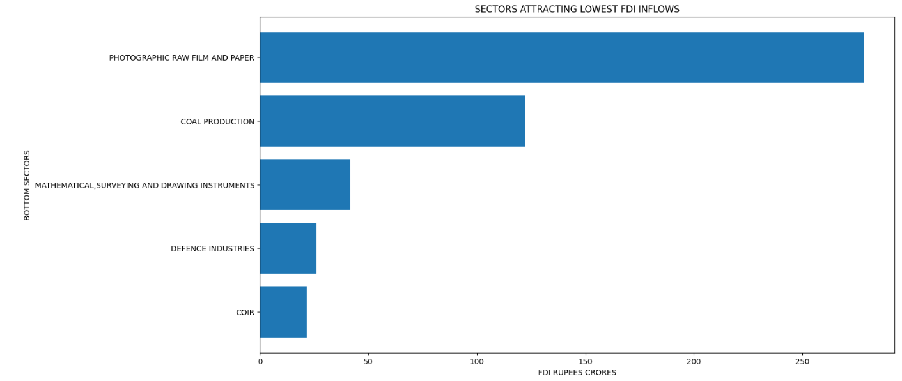
FDI INVESTMENT
THE bottom SECTORS UN-INTERESTED THEM
PHOTOGRAPHY AND PAPER, Coal,MATHS AND MORE ETC..,

Slide 8
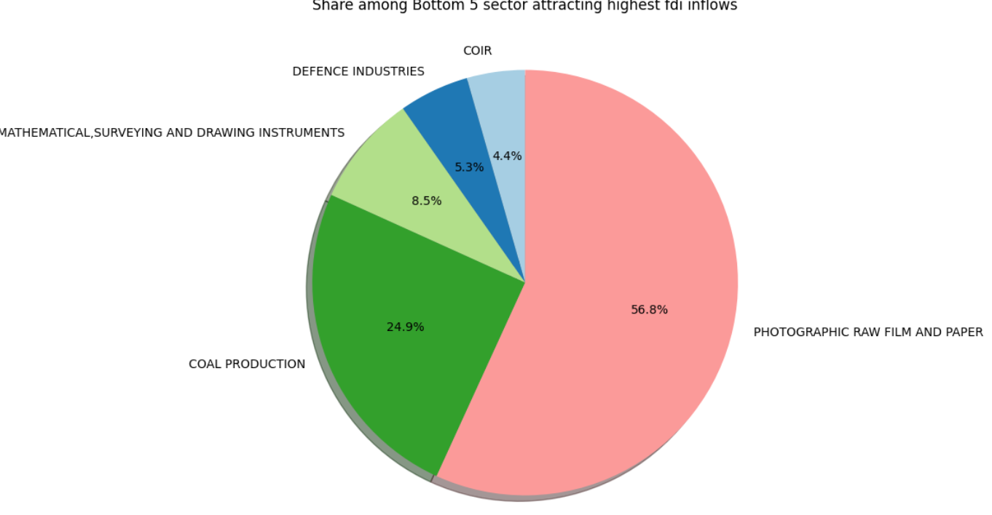
Inflows:
- Foreign investment coming into a country.
- Shows foreign entities investing in domestic assets.
- Can contribute to economic growth and development.
Outflows:
- Domestic investment going out of a country.
- Represents domestic entities investing in foreign assets.
- Helps domestic firms expand globally and access new markets.
FDI INVESTMENT
THE bottom SECTORS UN-INTERESTED THEM
HIGHEST INFLOWS SURVEY

Slide 9
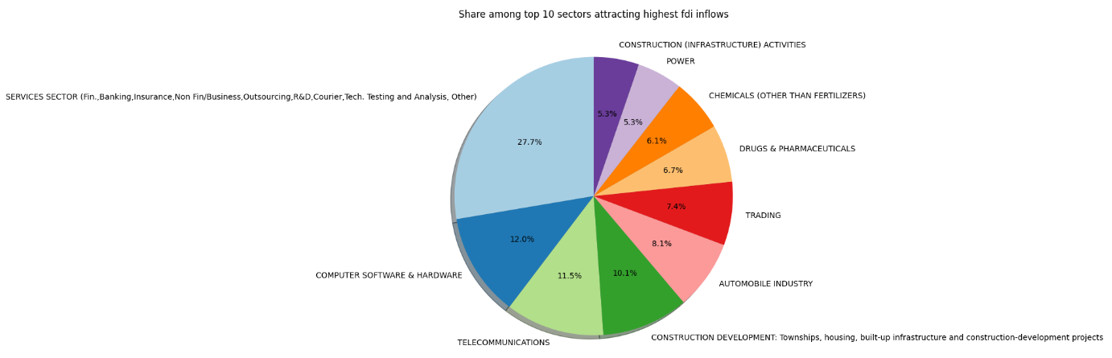
FDI INFLOW SECTORS TOP 10

Slide 10
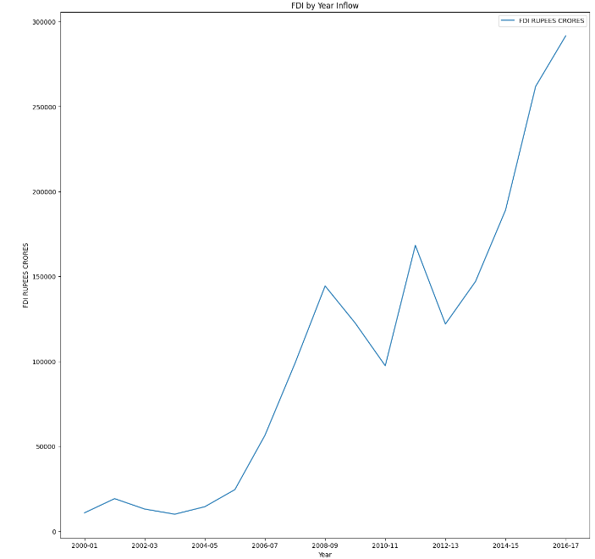
The Investment of the FDI keeps increasing Year by Year
An increase in FDI (Foreign Direct Investment) year by year typically indicates growing confidence among foreign investors in the economic prospects and stability of a country.
It suggests that the country is becoming more attractive for foreign businesses to invest in due to factors such as market potential, favorable regulatory environment, political stability, infrastructure development, skilled workforce, and potential for high returns on investment.
- Neil Armstrong
RAPID INCREASE

Slide 11
THANKS!
fizafahameen@gmail.com
www.linkedin.com/in/fizafahameen
- Fiza Fahameen M

